Slide 1
dGen: Distributed Wind Model Assumptions
Presentation to DOE Wind Program
Ian-Baring Gould, Ben Sigrin, Robert Preus, Eric Lantz, and Mike Gleason
November 15, 2015

Slide 2
Presentation Objective
Review major algorithms and dGen model input variables
Finalize case studies
Identify topics for expanded discussion of model assumptions
Discuss additional industry members to add to the technical review committee

Slide 3
Presentation Overview
Review key model dynamics
Review core algorithms for modeling diffusion of technology
Summary of major input data assumptions
Wind-specific and tech agnostic
Detailed review of each major assumption
Default settings
Basis for settings
Known areas for improvement
Planned future work (Q1-Q2)

Slide 4
Key Model Dynamics
Models the deployment of distributed wind for behind-the-meter customers only
Includes: individual households and businesses making independent investment choice for an on-site wind system
Excludes: community wind, wind gardens, utility wind, virtual net-metering
Relationship to REEDS
REEDS models capacity expansion of utility (wholesale) wind generation
dGen models behind-the-meter applications only, based an individual customer’s load
Neither dGen nor REEDS accounts for community based wind that might be higher cost (not included in ReEDS) but also not behind the meter (dGen)
Does reduce overall wholesale energy demand, a portion of which would come from wind
Linkage w/ ReEDS developed for solar, and extendable for wind
System sizes:
Turbine sizes range from 2.5 kW to 1.5 MW, with hub heights from 20 to 80 m
For heavy industrial users, multiple 1.5 MW turbines may be installed
Competition between technologies:
The solar and wind markets are generally modeled in isolation, which assumes no competition
We recently added a feature to facilitate modeling of competition, but have not tested it thoroughly
Notes:
This is a good point to stop and ensure that DOE has no other questions about basic model dynamics.

Slide 5
Overview of Modeling Approach
Initiate a set of statistically representative customer agents that are imbued with characteristics (consumption, location, rates, incentives, etc.)
For each 2-year increment:
Apply technical and siting restrictions, to determine system sizing and resource quality
Determine net value of DW for eligible customers based on discounted cash flow analysis project costs and benefits
Model deployment of technology using Bass diffusion, where economics define the maximum market size and rate of adoption

Slide 6
dGen Core Model Algorithms
Populate the model with agents (potential customers) based on high-resolution geospatial database
Review agents for system siting (hub height) constraints
Viable agents then are provided a viable DW system size based on annual electricity consumption and local net metering policy
Wind resource is identified at each agent location
Bill savings calculated for each agent based on wind resource, electricity load, and retail rates
Cash flow analysis completed for each agent
Business model selected (host owned or leased)
Total potential market calculated based on customer economics
Diffusion theory used to determine how much of the potential market will adopt annually

Slide 7
Core Model Algorithms: Modeling Diffusion
Economic scale the overall long-term potential market size (“maximum market share”)
Economics are translated to maximum market share using adoption curves
Adoption curves are based on technology-agnostic literature
Adoption curves reflect that some people will adopt at poor economics, and not everyone will adopt at excellent economics
Changes in economic conditions expand or limit long term market potential
Time

Slide 8
dWind Input Parameters
Includes data on:
Wind resource and surface cover
Coincident hourly patterns of generation and consumption
Utility electricity rates structures
Allows the manipulation of:
Deployed price and how it changes over time
Turbine performance and how it changes over time
Federal, state, and local policies: incentives and net energy metering
Escalations in electricity rates over time
Growth in load over time
Adoption (max market share) curves
Financial terms (including leasing terms, by sector and over time)
A more detailed review of input parameters is planned.

Slide 9
Model Case Studies

Slide 10
Model Cases
Propose to conduct a bracket analysis using four simulation cases:
Best case: Most favorable DW development
Most likely case: Assume that DW can develop in a way similar to larger wind and solar markets
Business as usual case: Development is more reserved
Worst case: No real market changes
There will not be changes to the model for the different cases – only changes to the model inputs

Slide 11
Model Assumptions

Slide 12
Summary of Wind-Specific Model Assumptions
Assumption | Level of Support | Basis of Support
Turbine Performance (Current) | High | Empirical + Engineering Judgment + Analysis
Turbine Performance (Future) | High | Engineering Judgment
Turbine Performance Improvement Schedule | Low | Empirical + Analysis
Installation Costs (Current) | Medium | Empirical + Engineering Judgment
Installation Costs (Future) | Low | Empirical + Analysis
O&M Costs (Current) | Medium | Engineering Judgment
O&M Costs (Future) | Low | Empirical + Engineering Judgment
Financing | High | Empirical
Incentives | Low | Empirical + Analysis
[All] Do we want to include future projections in this presentation given the state they are currently in?
Notes:
Note:
Empirical = based on data
Empirical + Analysis = based on NREL analysis of empirical data
Engineering Judgment = based on logical decisions made by NREL on the basis of domain expertise and/or research

Slide 13
Summary of Model Assumptions (Tech Agnostic)
Assumption | Level of Support | Basis of Support
Electricity Rates and Rate Escalations | High | Empirical + Analysis
Net Metering | High | Empirical
Maximum Market Share Curves | High | Empirical
Load Growth | High | Empirical
Notes:
Note:
Empirical = based on data
Empirical + Analysis = based on NREL analysis of empirical data
Engineering Judgment = based on logical decisions made by NREL on the basis of domain expertise and/or research

Slide 14
Turbine Performance (Current)
Overview:
8 power curves in dGen
4 representing current turbines
Basis of Support:
Empirical: Reviewed [Robert: insert number] power curves for various size existing turbines
Analysis: Normalized power curves by rated power, constructed generic representative power curves with equal swept area and normalized annual energy
Planned Future Work:
Review by TRC
Default Settings:
Power Curve | Rotor Efficiency (m²/kWp) | Capacity Factor | Power Curve ID
Current Small Residential (2.5‑20 kw) | 3.07 | 0.29 | 1
Current Small Commercial (50‑100 kw) | 4.9 | 0.375 | 2
Current Midsize (250‑1000 kw) | 3.1 | 0.42 | 3
Current Large (1500 kw) | 4.9 | 0.385 | 4
[Mike/Ben] Add a back up slide all 8 actual power curves on them?

Slide 15
Turbine Performance (Future)
Overview:
Remaining 4 power curves represent possible near future and far future turbines
Basis of Support:
Engineering Judgment: Considered the maturity of existing tech at different size classes and the technical factors limiting tech improvements
Planned Future Work:
Review by TRC
Default Settings:
Power Curve | Rotor Efficiency (m²/kWp) | Capacity Factor | Power Curve ID
Near Future Small Residential (2.5‑20 kw) | 4.0 | 0.385 | 5
Far Future Small Residential (2.5‑20 kw) | 5.2 | 0.40 | 6
Near Future Small Commercial to Large (50-1500 kw) | 4.2 | 0.43 | 7
Large (1500 kw) | 5.2 | 0.44 | 8
[Robert] Be prepared to succinctly explain the specific assumptions and judgments you made for these

Slide 16
Turbine Performance (All)
[Mike/Ben] Consider adding the graphic with all power curves here. Use better color coding and line styles to thematically group by size class and type period.

Slide 17
Turbine Performance Improvement Schedule
Overview:
Power curves are assigned to each turbine size for each model year
Basis of Support:
[in progress]
Default Settings:
ID | Power Curve
1 | Current Small Residential-Scale Turbine
2 | Current Small Commercial-Scale Turbine
3 | Current Mid-Size Turbine
4 | Current Large Turbine
5 | Near Future Small Residential-Scale Turbine
6 | Far Future Small Residential-Scale Turbine
7 | Small, Mid-Size, and Large Near Future Turbine
8 | Small, Mid-Size, and Large Far Future Turbine
Turbine Size (kw) | 2014 | 2016 | 2018 | 2020 | 2022 | 2024 | 2026 | 2028 | 2030 | 2032 | 2034 | 2036 | 2038 | 2040 | 2042 | 2044 | 2046 | 2048 | 2050
2.5 | 1 | 1 | 5 | 5 | 5 | 6 | 6 | 6 | 6 | 6 | 6 | 6 | 6 | 6 | 6 | 6 | 6 | 6 | 6
5 | 1 | 1 | 5 | 5 | 5 | 6 | 6 | 6 | 6 | 6 | 6 | 6 | 6 | 6 | 6 | 6 | 6 | 6 | 6
10 | 1 | 1 | 5 | 5 | 5 | 6 | 6 | 6 | 6 | 6 | 6 | 6 | 6 | 6 | 6 | 6 | 6 | 6 | 6
20 | 1 | 1 | 5 | 5 | 5 | 6 | 6 | 6 | 6 | 6 | 6 | 6 | 6 | 6 | 6 | 6 | 6 | 6 | 6
50 | 2 | 2 | 2 | 7 | 7 | 7 | 7 | 8 | 8 | 8 | 8 | 8 | 8 | 8 | 8 | 8 | 8 | 8 | 8
100 | 2 | 2 | 2 | 7 | 7 | 7 | 7 | 8 | 8 | 8 | 8 | 8 | 8 | 8 | 8 | 8 | 8 | 8 | 8
250 | 3 | 3 | 7 | 7 | 7 | 7 | 7 | 7 | 8 | 8 | 8 | 8 | 8 | 8 | 8 | 8 | 8 | 8 | 8
500 | 3 | 3 | 7 | 7 | 7 | 7 | 7 | 7 | 8 | 8 | 8 | 8 | 8 | 8 | 8 | 8 | 8 | 8 | 8
750 | 3 | 3 | 7 | 7 | 7 | 7 | 7 | 7 | 8 | 8 | 8 | 8 | 8 | 8 | 8 | 8 | 8 | 8 | 8
1000 | 3 | 3 | 3 | 7 | 7 | 7 | 7 | 7 | 8 | 8 | 8 | 8 | 8 | 8 | 8 | 8 | 8 | 8 | 8
1500 | 4 | 4 | 4 | 4 | 8 | 8 | 8 | 8 | 8 | 8 | 8 | 8 | 8 | 8 | 8 | 8 | 8 | 8 | 8
Planned Future Work:
[in progress]
[Ben/Mike] Update schedule with final version from Robert
[Robert] are there important transition points we want to call out here?

Slide 18
Installation Costs (Current)
Overview:
Two parameters for costs:
Baseline capital costs ($/kw) based on default tower height
Marginal costs for taller towers above default height
Basis of Support:
Empirical: Reviewed project cost information from [Robert: add count] datasets; interviewed [Robert: add count] manufacturers
Analysis: Determined median costs for systems at various heights and for marginal tower height costs
Areas for Improvement:
Sparse data available for marginal tower costs for 250-750 kw turbines
Default Settings:
Turbine Rated Power (kW) | Baseline Capital Cost ($/kW) | Full Cost ($) | Default Turbine Height (m) | Marginal Tower Cost ($/kW*m)
2.5 | $10,045 | $25,113 | 20 | $211
5 | $7,785 | $38,925 | 30 | $164
10 | $6,914 | $69,145 | 30 | $118
20 | $6,459 | $129,186 | 30 | $71
50 | $5,858 | $292,879 | 30 | $15.70
100 | $5,402 | $540,238 | 40 | $11.30
250 | $3,525 | $881,232 | 50 | $10.80
500 | $2,961 | $1,480,283 | 50 | $9.90
750 | $2,630 | $1,972,827 | 50 | $9.00
1,000 | $2,396 | $2,396,206 | 80 | $8.10
1,500 | $2,185 | $3,277,628 | 80 | $6.40
Planned Future Work:
Additional research into tower costs for 250-750 kw turbines

Slide 19
Installation Costs (Future)
Overview:
Costs for each turbine size are specified for each model year
Basis of Support:
[in progress]
Areas for Improvement:
[in progress]
Default Settings:
[Add graphic show cost trajectories, once they are determined]
Planned Future Work:
Review by TRC

Slide 20
O&M Costs (Current)
Overview:
Fixed O&M costs account for scheduled and unscheduled maintenance
Assume no variable O&M [be prepared to justify this]
Basis of Support:
Empirical: Interviewed [Robert: add count] manufacturers, leasing companies, installers, and consultants
Analysis: Fit linear regression to collected data to estimate O&M costs at model turbine sizes
Areas for Improvement:
Lacking data for unscheduled maintenance at size extremes (2.5-10 kw and 750-1500 kw)
Insufficient sample size to capture important mechanical transitions around 50-100 kw
Default Settings:
Turbine Rating (kW) | Scheduled O&M ($/kW) | Unscheduled O&M ($/kW) | Total Fixed O&M ($/kW)
2.5 | 27.64 | 11.3 | $38.94
5 | 27.62 | 11.3 | $38.92
10 | 27.58 | 11.3 | 38.88
20 | 27.5 | 11.3 | 38.8
50 | 27.27 | 11.29 | 38.56
100 | 26.87 | 11.28 | 38.15
250 | 25.69 | 11.25 | 36.94
500 | 23.71 | 11.2 | 34.91
750 | 21.74 | 11.15 | $32.89
1000 | 19.76 | 11.1 | $30.86
1500 | 15.81 | 11 | $26.81
Planned Future Work:
Additional data collection/interviews focused on extreme size classes
If sufficient data available, fit separate regressions for 2.5-50 kw and 50-1500 kw

Slide 21
O&M Costs (Future)
Overview:
O&M costs for each turbine size are specified for each model year
Basis of Support:
[in progress]
Areas for Improvement:
[in progress]
Default Settings:
[Add graphic show O&M cost trajectories, once they are determined]
Planned Future Work:
Review by TRC

Slide 22
Financing (Current)
Overview:
Financing parameter specified separately for each business model and market sector
Basis of Support:
Engineering Judgement: Financing costs based on opportunity cost of capital based on public debt
Areas for Improvement:
Lessor hurdle rates are based on historical rates for solar leasing companies
Default Settings:
Res Host-Owned: 20 yr loan, 20% down, 5% APR (current 20-yr home equity loan)
Non-Res Host-Owned: 20 yr loan, 40% down, 5.25% APR (current 20-yr AA corporate bond)
Res TPO: 20yr lease, 0% down, 0% escalation, lessor rate of return of 7% (Davidson et al 2015)
Non-Res TPO: 20yr lease, 0% down, 0% escalation, lessor rate of return of 7% (Davidson et al 2015)
Planned Future Work:
Contact wind leasing companies (United Wind) to request information on leasing parameters

Slide 23
Financing (Future)
Overview:
Financial parameters can also be specified to vary by model year
Basis of Support:
[in progress]
Planned Future Work
Review by financial modeling experts within NREL’s Strategic Energy Analysis Center
Default Settings:
[Ben: add charts with default settings]

Slide 24
Incentives (Federal)
Overview:
Federal ITC level can be specified by market sector and model year
Basis of Support:
Engineering Judgement: Assume continuation of existing ITC policy under business-as-usual
Planned Future Work
Review by TRC
Default Settings:
Year | Residential | Commercial | Industrial
2014 | 30% | 30% | 30%
2016 | 30% | 30% | 30%
2018 | 0% | 10% | 10%
2020 | 0% | 10% | 10%
2022 | 0% | 10% | 10%
2024 | 0% | 10% | 10%
2026 | 0% | 10% | 10%
2028 | 0% | 10% | 10%
2030 | 0% | 10% | 10%
2032 | 0% | 10% | 10%
2034 | 0% | 10% | 10%
2036 | 0% | 10% | 10%
2038 | 0% | 10% | 10%
2040 | 0% | 10% | 10%
2042 | 0% | 10% | 10%
2044 | 0% | 10% | 10%
2046 | 0% | 10% | 10%
2048 | 0% | 10% | 10%
2050 | 0% | 10% | 10%

Slide 25
Incentives (State and Local)
Overview:
State and local incentives can either be sourced from DSIRE database or user-defined inputs
Basis of Support/Default Setting:
Empirical: DSIRE database is used as the default source for state and local incentives
Areas of Improvement:
DSIRE data has not been updated since 2013 and is missing key information (e.g., expiration dates)
Planned Future Work
Replace/update DSIRE data with policy data from PNNL

Slide 26
Detailed Model Assumptions: Technology-Agnostic

Slide 27
Electricity Rates (Current)
Overview:
Three options for rates:
Real-world tariffs based on the Utility Rate Database (URDB)
Annual average flat rates by county (EIA 861)
User-defined flat rates by state
Basis of Support/Default Setting:
Empirical: Real-world tariffs from the URDB are the default setting. These most closely resemble the current electricity costs incurred by electricity consumers in the US.
Planned Future Work
Review by TRC

Slide 28
Electricity Rate Escalations (Future)
Overview:
Future retail rates are based on AEO2015 regional escalation forecasts. Alternative future rate structures may be evaluated, but current structures are used by default
Basis of Support:
Empirical: AEO 2014 & 2015 Reference Case projections provide rate escalations through 2040; rates are constant in real-terms thereafter
Analysis: We developed a time series model to extrapolate growth 2040+ based on AEO2015 forecast (2015 – 2040)
Engineering Judgment: We use AEO2015 (Constant after 2040) as the default because it is the most recent and conservative option
Planned Future Work
Review by TRC
Default Settings:
AEO 2015 (rate escalations in real terms ($2014), regional scaling factor, rates are constant in real terms 2040+)
Alternative Settings:
AEO2015 + Extrapolation 2040+
AEO 2014
No growth
User defined

Slide 29
Net Energy Metering Policies (Current and Future)
Overview:
Net Energy Metering (NEM) outflow credit valuation and maximum system size can be set by state and sector
NEM expiration years can also be set by state
Basis of Support/Default Setting:
Empirical: Default NEM maximum system sizes by state and sector are based on current policy (Barnes et al. 2013).
Empirical: Non-NEM outflow credit valuation is based on projected wholesale electricity rates by state and model year using the ReEDS ATB Central Scenario
Analysis: Default NEM expiration years by state are based comparison of a recent dGen BAU run for the solar market against cumulative state NEM limits from Barnes et al. (2013).

Slide 30
Maximum Market Share Curves
Overview:
Maximum market share (MMS) curves relate economic attractiveness to long-term market potential
The model includes several sources for MMS curves
Basis of Support:
Empirical: The model includes several published MMS curves for host-owned systems, and one curve for leased systems
Engineering Judgment: We use curves from Paidipati et al. (2008) for host-owned systems for consistency with previous research (SunShot Vision Study) and because it is less extreme than other options. We use the only available curve for leased systems
Areas for Improvement:
The default MMS curves are all based on the solar market [do we need to add some text here for further justification?]
Default Settings:
Host-Owned MMS: Paidipati et al. (2008)
[Ben or Mike: add graphic showing MMS curve from navigant]
Leased MMS: Sigrin and Drury (2013)
[Ben or Mike: add graphic showing MMS curve from willingness to pay research]
[all] could trim this down if we decide include slide at the beginning outlining how diffusion works
Planned Future Work:
May update leasing MMS curve using more recent solar data
Review by TRC

Slide 31
Load Growth Projections (Future)
Overview:
Load growth is implemented in the model as population growth in each sector
10 load growth scenarios are available, all from AEO 2014 and 2015
Basis of Support:
Empirical: AEO 2014 & 2015 Reference Case projections provide 5 different scenarios each.
Engineering Judgment: We use AEO 2015 (Reference Case) as the default because it is the most up-to-date, business-as-usual case available from AEO
Planned Future Work
Review by TRC
Default Settings:
AEO 2015 (Reference Case)
[Ben or Mike: add graphic showing different load growth scenarios?]

Slide 32
Summary
[ all ] should we bother including a conclusions/summary slide?

Slide 33
Model Algorithms

Slide 34
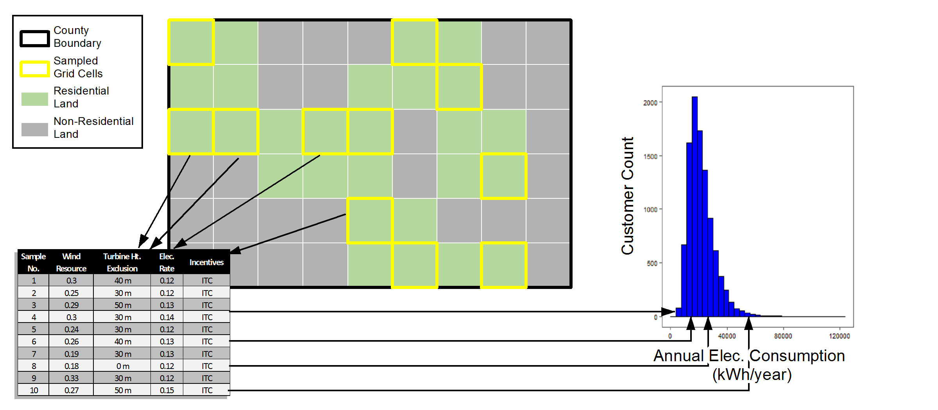
Statistical Representation of Customers
To reconcile data sets of disparate resolutions, we represent customers through a statistical framework
1) Sample points in county. Each point represents a customer. There may be more than 1 per cell.
3) Randomly associate customer segments with national distributions, such as customer load patterns
2) Associate with exclusions, CF, rates, etc.

Slide 35
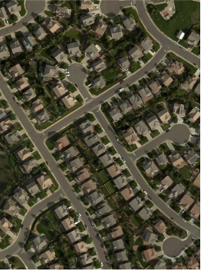
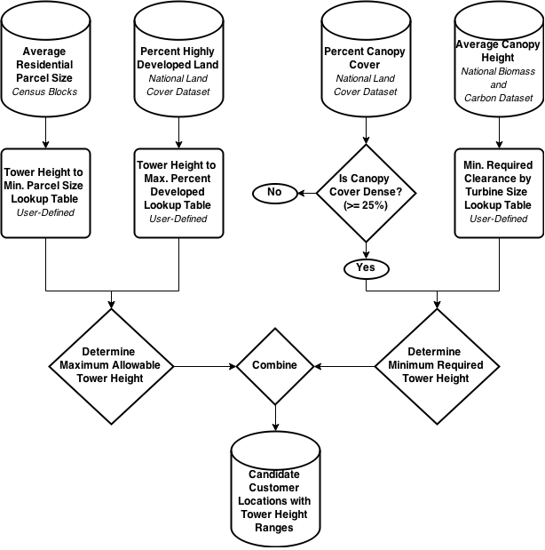
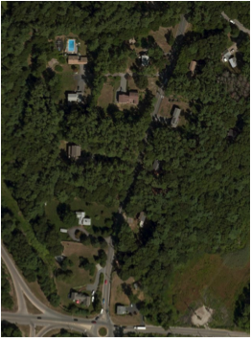
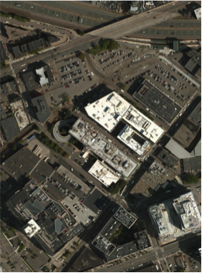
Turbine Siting Criteria
Parcel Size
TREE COVER
AND HEIGHT
HIGHLY DEVELOPED,
LAND

Slide 36
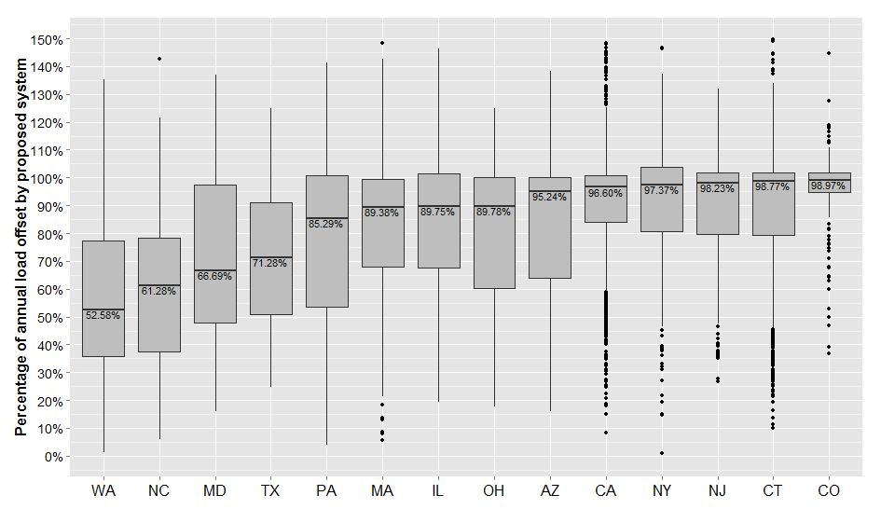
Agent System Sizing
The prospective wind system is sized to meet a user-defined percentage of annual electricity consumption
Sizing targets vary for customers with and without net-metering
Sizing of Distributed Solar Systems from Actual Quote Data
Source: Davidson et al. (2015)

Slide 37
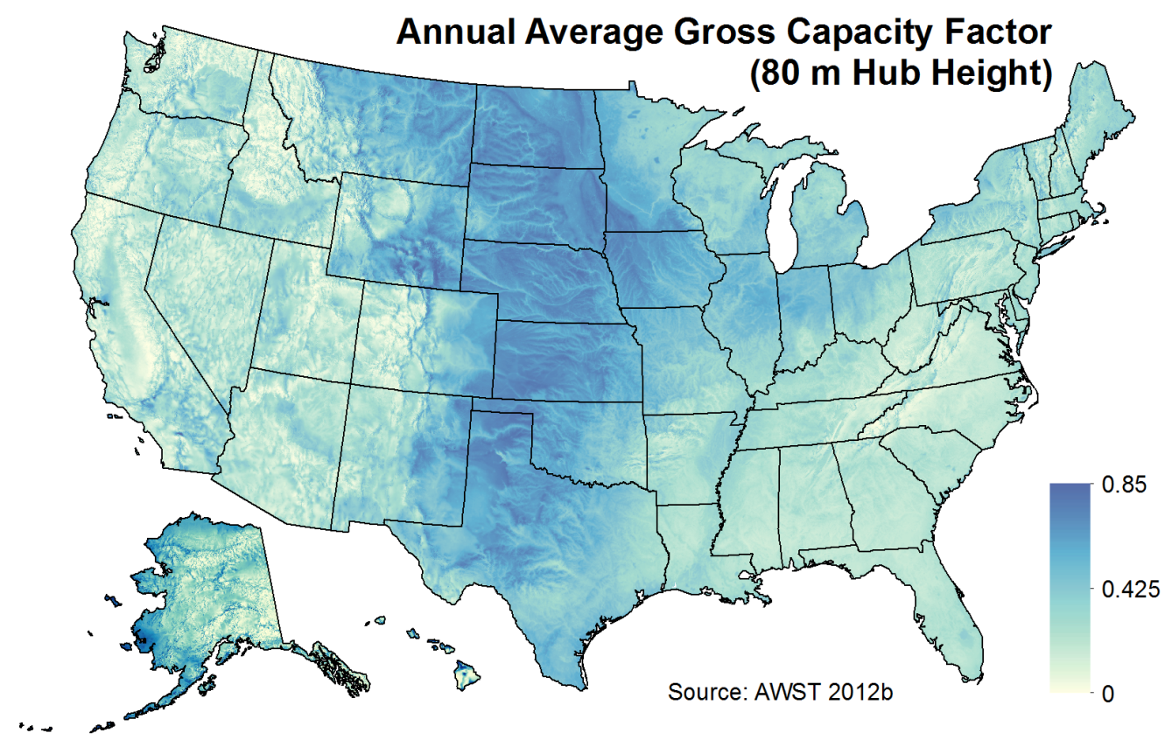
Wind Resource
Wind resource is derived from a gridded dataset of hourly wind speed data, licensed by NREL from AWS TruePower and consist of hourly average wind speeds for the “typical meteorological year” (TMY) at each location (AWST 2012a).
These TMY hourly profiles represent typical historical conditions at each grid cell based on 14 years of historical wind speed data (AWST 2012c).
A tool developed by domain experts at the NWTC is used to convert wind speeds to hourly kWh generation, based on WTG power curves
Resource data is resolved in the model at 200m level for hub heights of 20, 30, 40, 50, & 80m

Slide 38
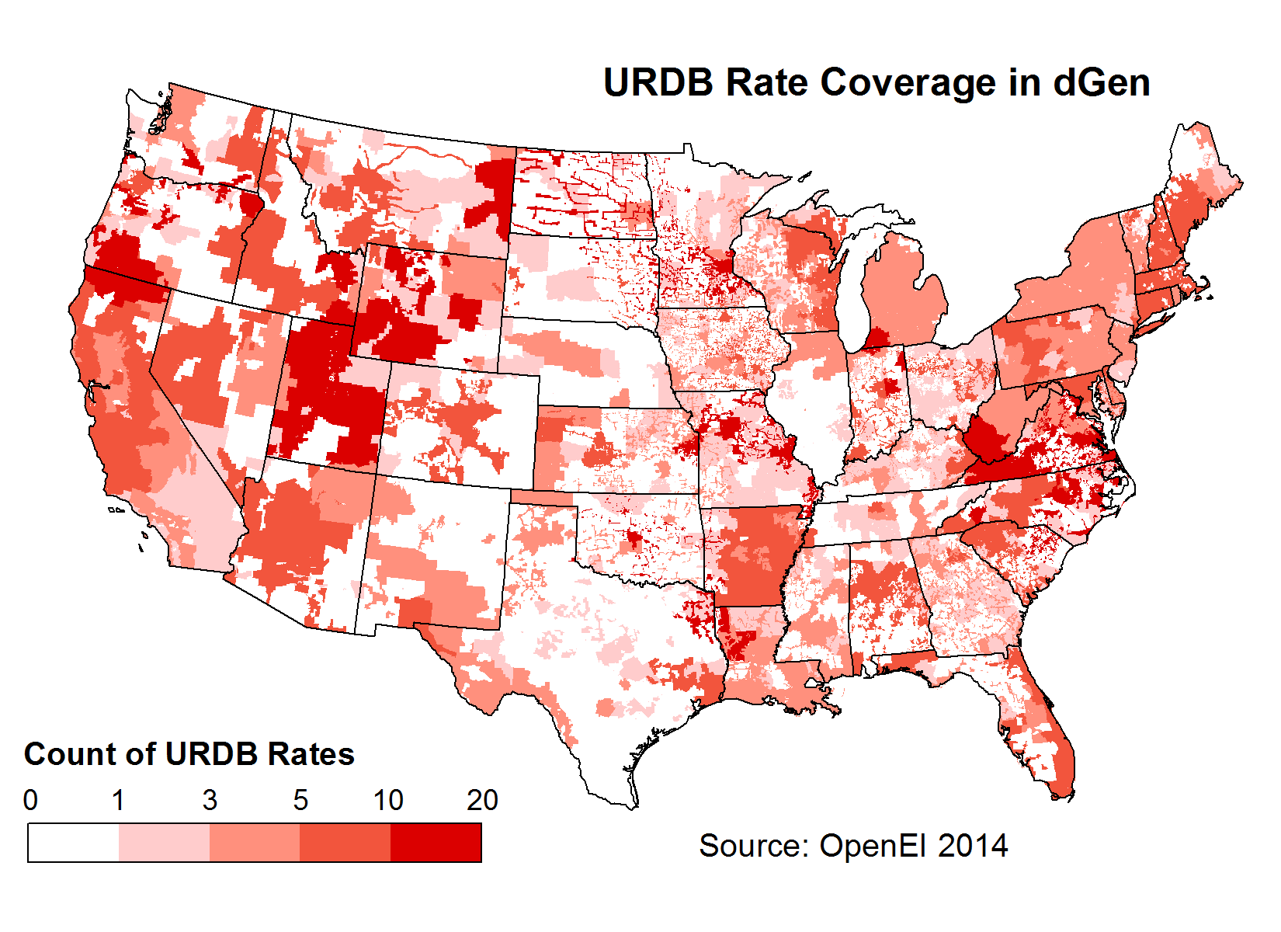
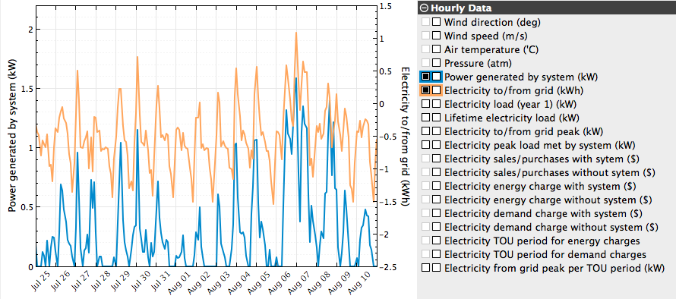
Calculation of Bill Savings
Bill savings are calculated using the System Advisory Model (SAM) based on each agent’s:
Regional Rate Tariff
Hourly Electricity Consumption
Hourly Wind Generation
Notes:
Current generic curves are based on a representative currently available turbine. Ration of area to rating used and efficiency adjusted till AEP matched turbine selected at 5.5 m/s. Power level capped at rating.

Slide 39
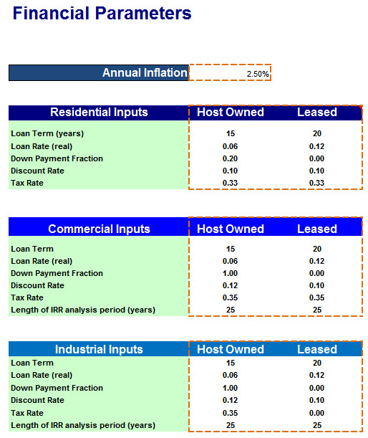
Cash Flow Analysis
Discounted cash flow calculation is used to determine economic attractiveness based on:
System costs
Revenue from bill savings
Revenue from incentives
Revenue from tax deductions (depreciation, loan interest, etc.)
High level of customization of financing terms
Systems can be host-owned (buy) or third party-owned (lease)
Produces outputs including:
Payback period
Internal rate of return
Net Present Values

Slide 40

Selection of Business Model
Agents select from host-owned and third-party business models through a probabilistic comparison of the net present value (NPV) of both options
The probability of an agent selecting the leasing model (P_{L}) is defined using a standard logit equation:
where:
N_{L} = NPV of leasing
N_{B} = NPV of buying
α = segregation parameter with a default value = 2
In this formulation, the agent is indifferent to either model when both models provide equal economic benefits, but it is likely to prefer the business model with superior economics.

Slide 41
Summary of data sets used
Description | Source | Spatial Resolution
Resource Quality - Annual Energy Production | AWST 2012a, AWST 2012b, Dobos 2015, George et al. 2007, NSRDB 2015 | 200 m by 200 m
Potential Agent Locations | ORNL 2011, HSIP 2012 | 200 m by 200 m
Additional Technology-Dependent Siting Criteria (e.g., roof orientation, minimum and maximum turbine heights) | ORNL 2011, HSIP 2012, Gagnon et al. (2015) | 200 m by 200 m
Prevailing Retail Electricity Rates (2014) | OpenEI 2014 | Electric Utility Service Territories
Applicable Incentive Policies | DSIRE 2014 | Variable: Electric Service Territories, County, State, Nation
Existing Net-Metering Availability | Barnes et al. 2013 | State
Total Annual Electric Load by County | Ventyx 2012 | County
Total Count of Electric Customers by County | Ventyx 2012 | County
Microdata Representations of Customer-Level Electric Load | EIA 2008 | Census divisions (multistate regions)
Load Growth Projections | EIA 2015b | Census divisions (multistate regions)
Electricity Rate Projections | EIA 2015b | Nation
Financing Parameters | DOE 2012 | Nation

Slide 42
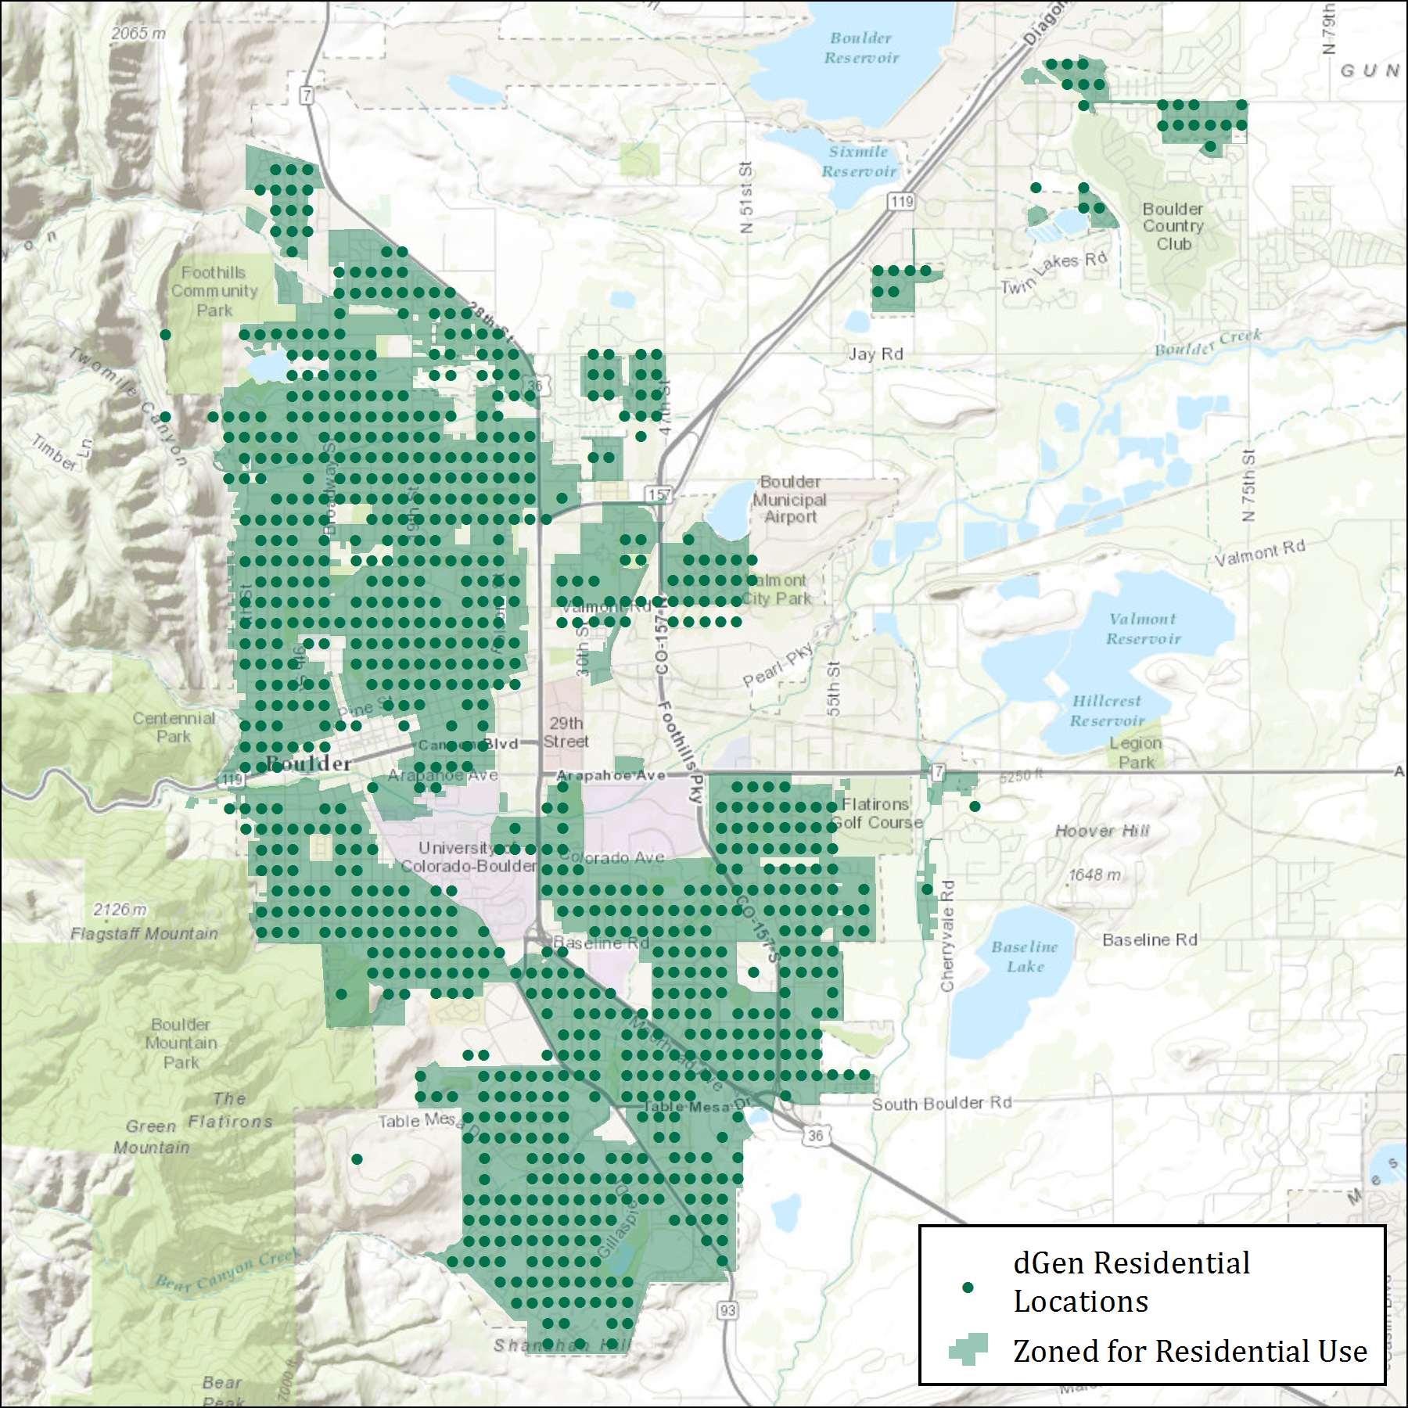
Geospatial Database Framework
dGen is supported by a highly resolved geospatial database that integrates several local and regional datasets
Some datasets are resolved down to 200 m by 200 m grid cells
Agent locations
Canopy height and cover
Building density
Wind resource

